Slide 1

RPA Design & Development
Variables

Slide 2
Variables
Variables are storage containers for data that can be later used throughout the program.
1, 2, 3
Counter
Keep track of a certain repetitive action, like clicking on an item
Comments
Store the comments for each action item
Hello!
Organized Items
Store organized items of interest to the users that clicked on them

Slide 3




Actions associated with Variables
Some of the actions associated with variables are:
Create it
Add content in it
Reuse it
Get info out of it

Slide 4
Properties of Variables
Name
Title of the information stored by the variable
Type
Type is classification of variable based on the type of data it is intended to store.
Value
The expression value assigned to the variable
Scope
Designate which parts of the program can see it or use it (local, global)
Lifetime
Lifetime of a variable ends when program leaves its scope
Location (Memory)
The place where variable is stored in the computer hardware

Slide 5
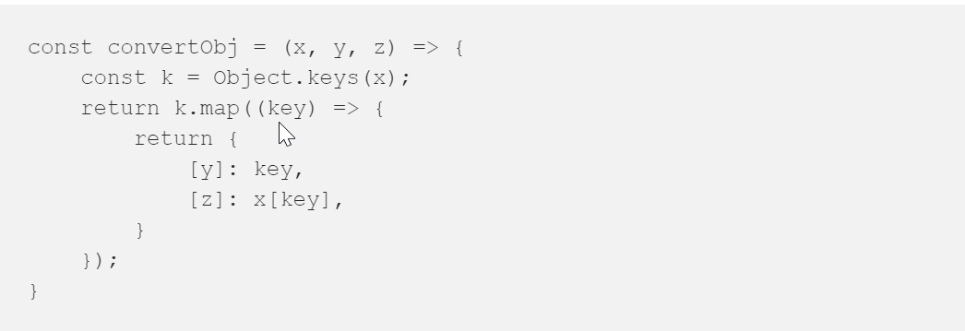
Naming Best Practices
Anything wrong with the naming in this piece of code?

Slide 6
Types of Variables
Number
Array
String
Stores Numerical Data
Stores multiple values
Stores Text
Date & Time
Boolean
DataTable
Stores Date and Time
Stores True or False
It store the information

Slide 7
Number
Number
Array
Definition
Example
Usage
String
Number variables can store numerical values.;
An example of number variable can be the age of a person.
Int age = 34;
Used to store a certain numerical value inside them and reuse it whenever needed in the program.
Date & Time
Boolean
DataTable

Slide 8
Number
Array
Array
Definition
Example
Usage
String
An array is a data structure that contains a group of elements of the same data type, such as an integer or string.
arrayname[0] = "This ";
arrayname[1] = "is ";
arrayname[2] = "pretty simple.";
print arrayname[0];
print arrayname[1];
print arrayname[2];
;
Used to organize data so that a related set of values can be easily sorted or searched.
Date & Time
Boolean
DataTable

Slide 9
Number
String
Array
Definition
Example
Usage
String
String Variables help us store any kind of text on which arithmetical operations will not be applied.
arrayname[0] = String firstName = Alex;
String lastName = Jackobsen;
The main usage of string variables is to store text and reuse it in our code for specific actions.
Date & Time
Boolean
DataTable

Slide 10
Number
Date & Time
Array
Definition
Example
Usage
String
Enables you to store information about any date and time.
DateTime value = new DateTime(2017, 1, 18);
Used to store a specific date and time
Date & Time
Boolean
DataTable

Slide 11
Number
Boolean
Array
Definition
Example
Usage
String
The Boolean variable has true or false values.
Boolean user = true;
Boolean variables are used with control statements to help determine the flow of a program.
Date & Time
Boolean
DataTable

Slide 12
Number
DataTable
Array
Definition
Example
Usage
String
Variable that can store large pieces of data.
A database table
A simple spreadsheet
Structured data
;
They are used to store big pieces of information and do certain operations on it, such as, filtering, searching, copying, etc.
Date & Time
Boolean
DataTable

Slide 13
Webform Exercise
Think about the variables you need in a webform
Your client is a company that collects recycled oil.
They need to have a webform created for them with the purpose of scheduling the time for collecting the oil from the customers.
They would need to collect data about customers:
First and last name
Age
Address
Date when the oil can be collected
Time range in which the oil can be collected
Phone number
Comments
What variable types would be used?
Notes:
The following variables will be needed in the webform:
First and last name: String
Age: Integer
Address: Array
Date when the oil can be collected: Date & Time
Time range in which the oil can be collected: Date & Time
Phone number: Integer
Comments: String

Slide 14
Types of Variables in UiPath
Integer
String
Boolean
Array
Generic

Slide 15
UiPath Specific Variable - GenericValue
Text
Numbers
GenericValue
Dates
Arrays

Slide 16
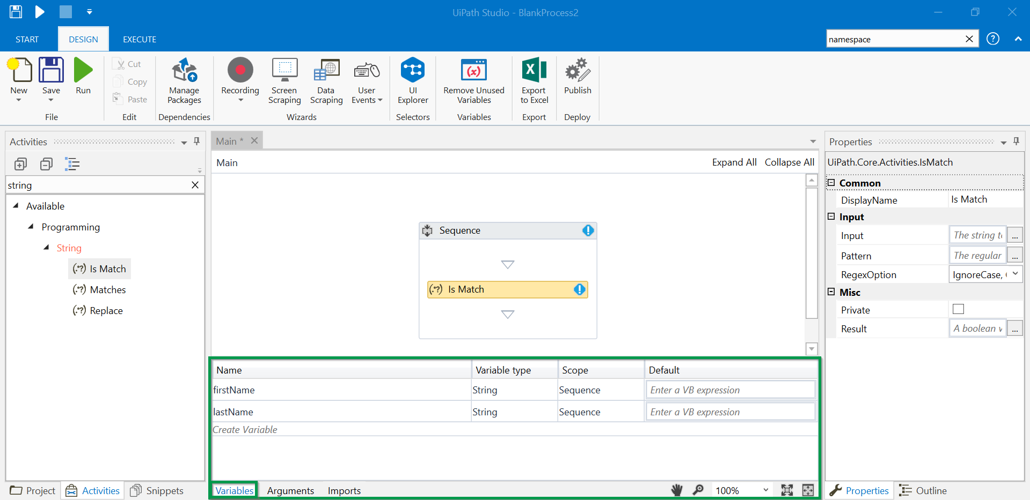
Variables Panel in UiPath Studio

Slide 17
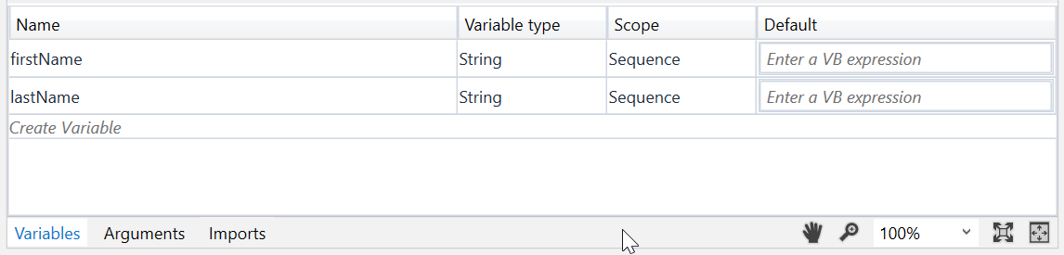
Variables Panel in UiPath Studio (Contd.)
Variable Type
Scope
Default
Name
Specify the data type for your variable
Specify the scope of your variable
Specify if your variable should have a default value or not.
Give a proper name to your variables

Slide 18

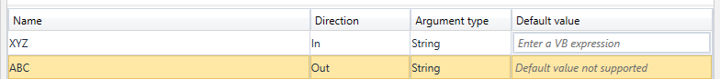
Variables vs. Arguments
Variables
Arguments
only used inside a single workflow file(.xaml) in your project
Types of Variable: Boolean, Array, Integer, text., Datatable
It is used to pass it other activities.
You can change the variable name multiple times
used to pass data from one workflow file to another
have a specific direction – In, Out, In/Out
Type of Argument: Argument, Property, Direction, Default etc.
Variable
Arguments

Slide 19
Practice makes perfect…
We have two workflow files, ReadValues.xaml and SumValues.xaml
The first workflow file reads some data, and the second one does the addition of the values.
What directions should the two arguments have?
In
Out
In/Out

Slide 20
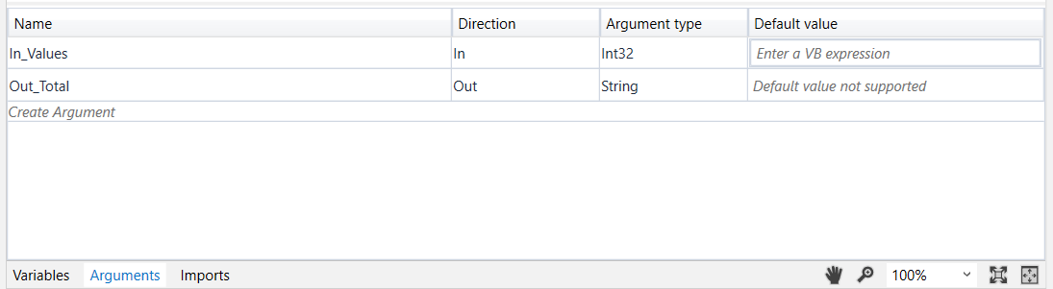
Arguments Panel in UiPath Studio
Name
Direction
Type
Default
Set up the direction of your argument
Specify the data type for your argument
Specify if your argument should have a default value or not.
Give a proper name to your arguments

Slide 21

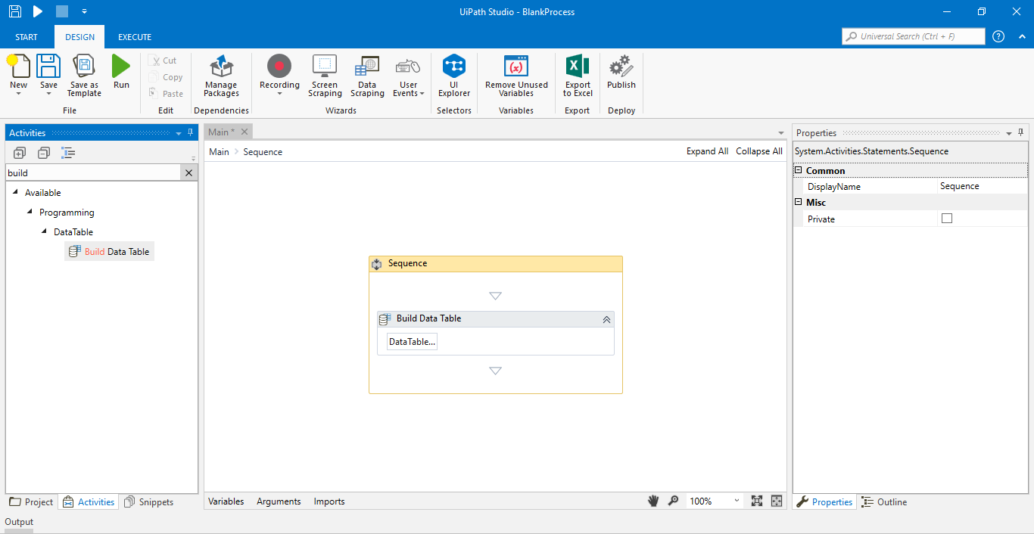
Exporting Variables in a Excel Sheet
Step 1: Drag and Drop The Sequence Workflow

Slide 22
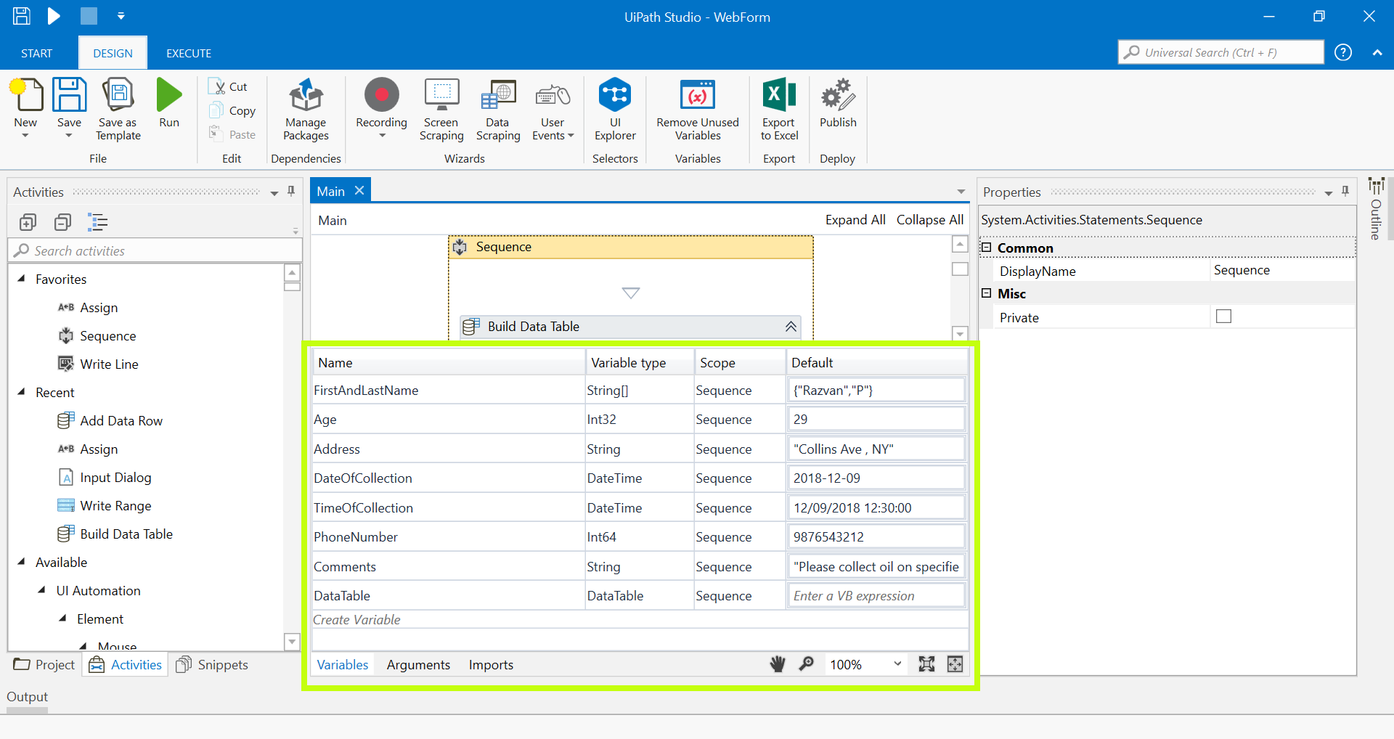
Exporting Variables in a Excel Sheet
Step 2: Open the Variables Panel to create variables of different data types and assign them values.

Slide 23
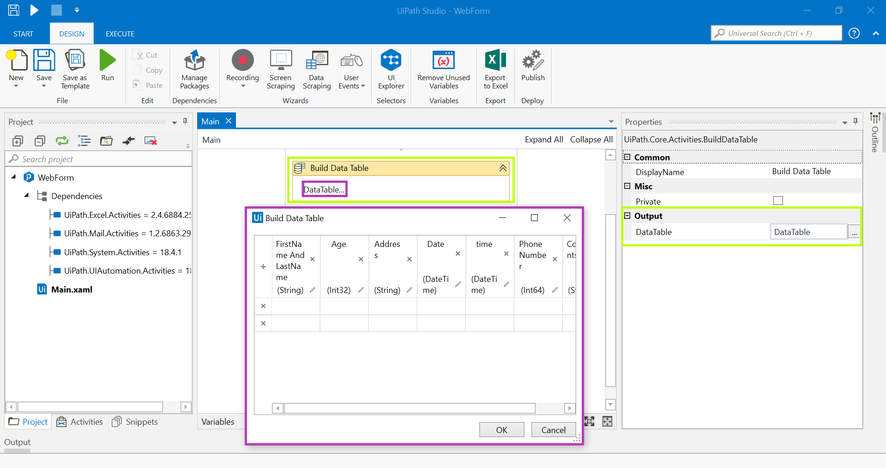
Exporting Variables in a Excel Sheet (Contd)
Step 3:
Navigate to the Activities Panel.
Drag and drop the DataTable activity in workflow.
Open Build DataTable wizard.
Create column names.
Output variable in the properties panel.

Slide 24
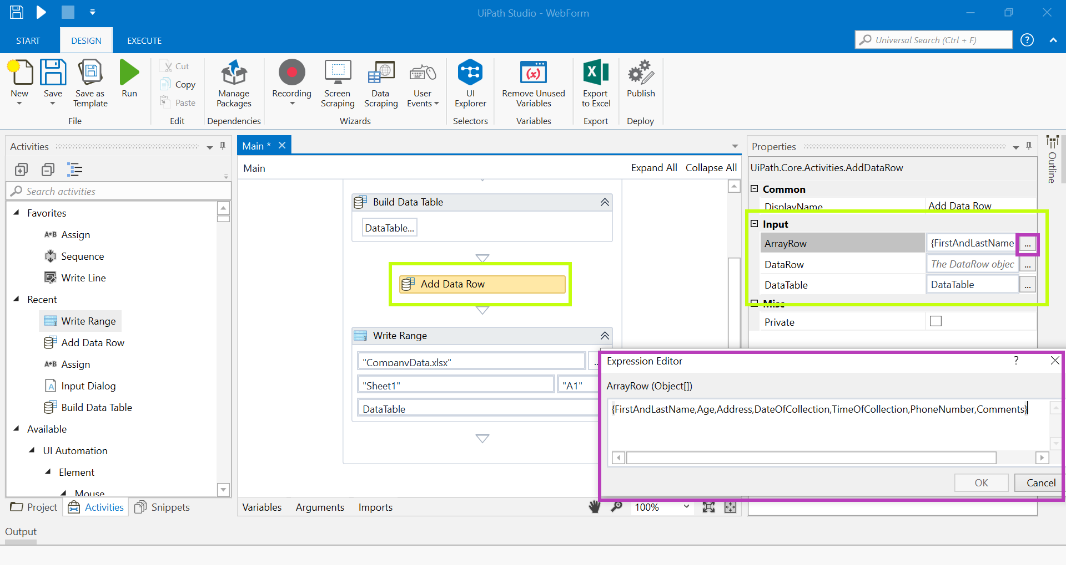
Exporting Variables in a Excel Sheet (Contd.)
Step 4:
Navigate to the Activities Panel.
Drag and drop the Data Row activity in workflow.
Add the variable names in the Properties panel.
Pass the name of the datatable created in the previous step.

Slide 25
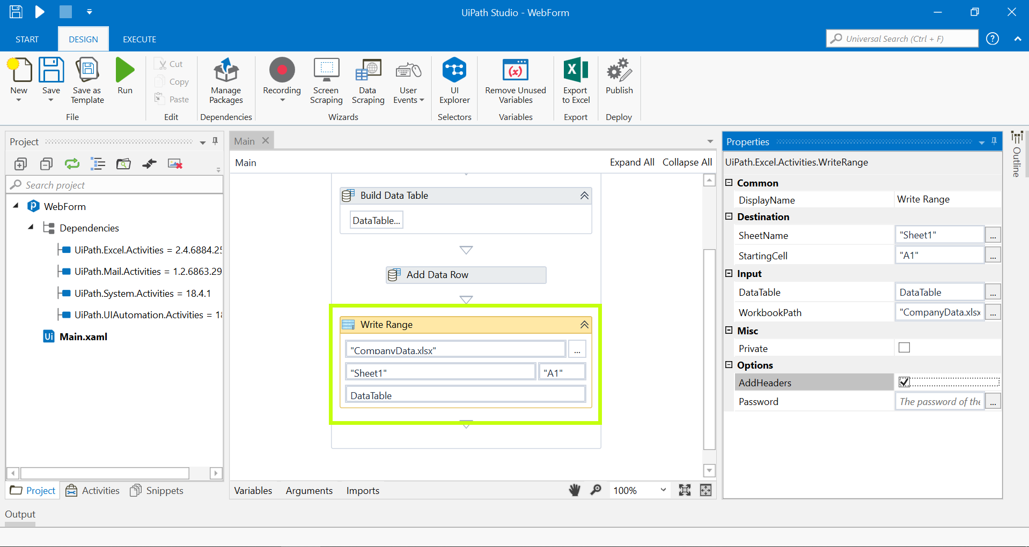
Exporting Variables in a Excel Sheet (Contd.)
Step 5:
Navigate to the Activities Panel.
Drag and drop the Write Range activity in workflow.
Write “CompanyData.xlsx” in workbook path.
Pass the datatable output variable name created in the previous step.

Slide 26
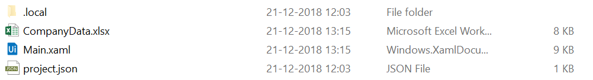
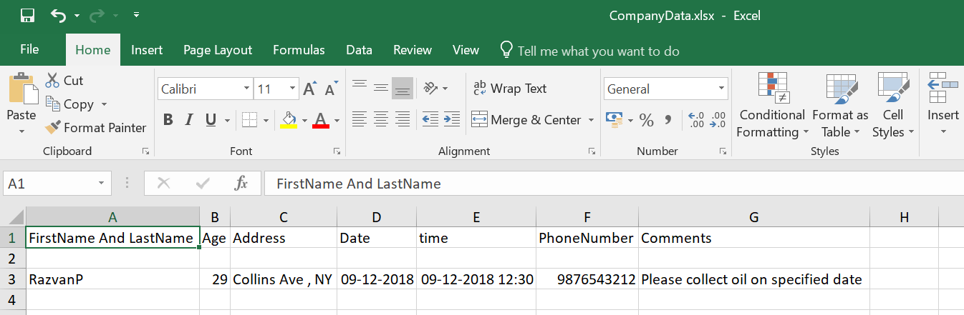
Exporting Variables in a Excel Sheet (Contd.)
Step 6:
Run the program.
An Excel sheet with the name CompanyName will be created in the project folder.

Slide 27
Questions & Answers

Slide 28
Which of the following is a UiPath specific Variable?
a) GenericArray
b) GenericValue
c) GenericDates

Slide 29
Which of the following is used to pass data from one workflow file to another in UiPath Studio?
a) Variables
b) Arguments

Slide 30
Next Steps
Control Flow

